Slide 1

DriverPass System Analysis
Thomas Bartlett
Notes:
[No speaker notes required for this slide.]

Slide 2

System Requirements
Functional Requirements:
The system shall be accessible from desktops, laptops, and mobile devices when they are connected to the internet.
The system shall allow customers to sign up for classes, tests, and on-the-road training based on the package they select.
The system shall validate user credentials when logging in.
Non-Functional Requirements:
Each user will have a unique login with a username and password.
The system should be updated in real time.
Notes:
The DriverPass system is being created to take advantage of a void in the market for training students to prepare them to take their driving test at their local department of motor vehicles. While discussing the needs and wants for this system, there were some that stood out as being important to the system. I have highlighted several of these as follows.
To have the system run as intended it should be accessible from any device with a web browser when they are connected to the internet. This is important for all who access the system. For DriverPass, this would allow you to do your job not only in the office, but also at home or on the go. For your customers, this will make your system accessible for a larger population. Especially with the constantly updating technology, more and more people are accessing applications via mobile devices, not just desktops or laptops.
Customers will also be able to access classes, tests, downloadable materials, and the ability to register for on-the-road training based on packages offered to them when they sign up for a profile on the system. This limits access of customers to just the portions of the system that they have paid for.
Access to the classes, tests, materials, and on-the-road training will depend on the package that the customer has paid for and will be verified when they login. To make sure that customers are only accessing what they paid for, the system will verify what they have access to at the time of login.
Each customer’s access will be verified by using a unique login that consists of a username and password. With using this type of login, it will be easier to track each customer using the system. It also helps the system be able to identify individuals and will tell the system what they should have access to.
The system will also reflect the most up to date information to be able to show customers their progress and status for classes and tests, the most updated information from the DMV, and notes from instructors if the customer is able to take advantage of on-the-road training. This will also help you when you need to run reports as the reports will reflect the most recent changes, or if you are needing to add or remove access of someone, these changes would be immediate.
This list is just a sampling of necessities that will be included in the system to meet your needs.

Slide 3
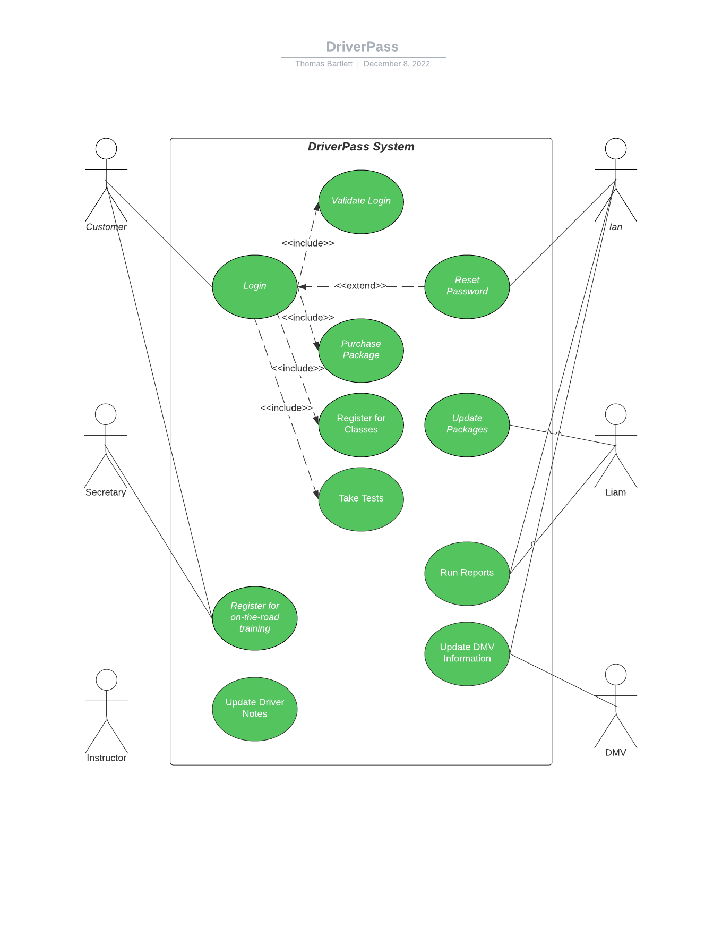
Use Case Diagram
Notes:
Within each system, you have different people or other systems that have access to parts of your system. For your DriverPass system these people consist of your customers, your secretary, your instructors, and yourselves (Liam and Ian). Your system will also provide a way for the DMV system to send any updates so you can provide the most up to date information from the DMV to your customers. As you can see, each person has access to certain parts of the system based on who they are.
Your customers can login to their profile where the system will verify who they are. From here they can purchase a package and access the classes and tests that are included based on the package they choose. They are also able to register for on-the-road training based on what package they purchased.
If the customer calls in, they would be speaking with your secretary who would be able to register them for their on-the-road training.
The instructors will be able to update their notes for each lesson so that your customers can have written feedback and can see their progress.
Ian would have access to be able to help reset passwords, run system reports, and update information provided by the DMV.
Liam, you would be able to run the same reports as Ian to track any changes made within the system as well as have the access to enable/disable a package that is already in the system as was discussed in our initial meeting.

Slide 4
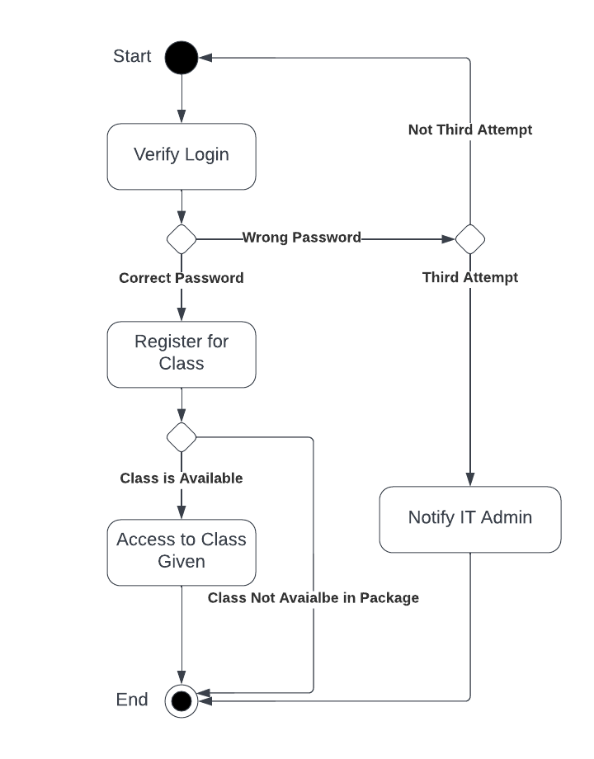
Activity Diagram: Accessing online class
Notes:
To provide you with an example of how the system will work, let’s look at what happens when a customer tries to access the online class:
First off, when the customer logs in, the system will verify that the username and password are valid. The system allows for three attempts per username before making the customer take actions to reset their password. After the third attempt it would also send an alert to the Admin so this could be investigated for potential hacking. If the correct username and password are provided, then the customer is logged into the system and can attempt to register for the online class. If the package the customer paid for does not include the online class, then registration is denied. If the customer’s package includes the online class, registration is accepted and access to the class is given.

Slide 5
Security
For a user to log in they will need to supply their unique username and password.
If there is a “brute force” hacking attempt on specific accounts, an email will be sent to the user and IT admin. The email will prompt the user to verify if this was them, and if not, to change their log in information. If the attempt is on the system as a whole, for example someone trying to hack into the database, an alert would be sent to the IT admin so a timely response to the attempt can be made to protect the system.
If the user forgets their password, there would be an option to be able to reset the password by answering security questions as well as providing a security code generated by the system and sent to the user’s email address or cell phone after correctly answering the security questions.
Notes:
Security for a system is very important, especially when there is sensitive information being supplied such as names, addresses, and financial information from your customers. For this reason, the system would require everyone to have a unique username and password to access the system.
If there was an attempt to gain access to a customer’s account and hacking is suspected, the account would be locked until the customer can verify it was them or take corrective action to secure their account by changing their username and/or password. If the attempt was to gain access to the system’s database, the breach would immediately alert the IT Admin so that a timely and proper response can be made to protect the system.
Another aspect of security that our design addresses is when allowing customers to reset their password if they forget it. To be able to reset the password, a set of security questions would need to be answered, and then a security code generated by the system would be sent to the customer’s email or cell phone and would need to be put in to reset the password.

Slide 6
System Limitations
Since the system will be provided over the cloud, availability of the system will rely on server availability.
Since financial transactions are not handled in house, availability of the payment system is dependent on a third party handler.
Since the system is accessed on the web, limitations on the performance of the system will be dictated by the internet speeds of the users.
DriverPass system and the DMV system may not interface properly which would restrict how quickly updates are obtained and available to users.
Future offerings of additional packages would require a developer to add these packages.
Notes:
There are some limitations of the system based on how it is designed.
Since the system would be developed on and accessed by a remote server from a cloud service, the availability of the system will rely on the server being up and running. This means that the availability of the server is not in your control but controlled by the third-party cloud service provider.
Along the same lines, since you will not have an in-house payment processing system, you are relying on the availability of the payment system from a third party.
Since the system is accessed via a web browser and internet connection, the performance of the system is limited to the internet speeds of the person trying to access the system.
Another limitation that has been identified is your system and the DMV’s system may not always be compatible, which could limit how quickly updates are received and then available to your customers on your system.
The last limitation addresses the future offerings of additional packages. As discussed, new packages would be difficult to add by a non-developer and you would need to have these changes provided by a developer in a future update to the system.

